Slide 1
Searching and Sorting

Slide 2
Searching
The process of selecting particular information from a collection of data based on specific criteria.
  Can be performed on different data structures.
  sequence search – search within a sequence.
  search key (or key) – identifies a specific item.
  compound key – consists of multiple parts.

Slide 3
Linear Search
Iterates over the sequence, item by item, until the specific item is found or the list is exhausted.
  The simplest solution to sequence search problem.
  Python's in operator: find a specific item.
if key in theArray :
print( 'The key is in the array.' )
else :
print( 'The key is not in the array.' )

Slide 4
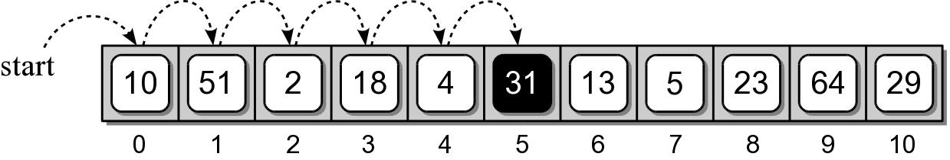
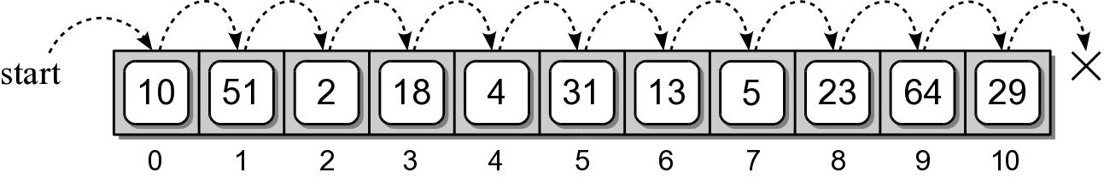
Linear Search Examples
Searching for 31
Searching for 8

Slide 5
Linear Search Code
def linearSearch( theValues, target ) :
n = len( theValues )
for i in range( n ) :
if theValues[i] == target
return True

Slide 6
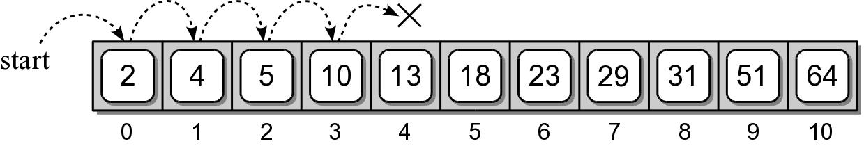
Linear Search: Sorted Sequence
A linear search can be performed on a sorted sequence.
Example: searching for 8.

Slide 7
Linear Search: Sorted Sequence
Similar to the unsorted sequence, with one major difference.
def sortedLinearSearch( theValues, target ) :
n = len( theValues )
for i in range( n ) :
if theValues[i] == target :
return True
elif theValues[i] > target :
return False
return False

Slide 8
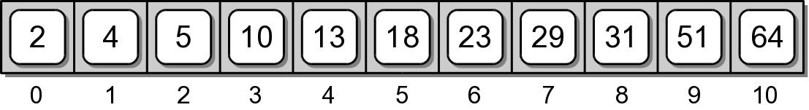
Binary Search
The linear search has a linear time-complexity.
  We can improve the search time if we modify the search technique itself.
  Use a divide and conquer strategy.
  Requires a sorted sequence.

Slide 9
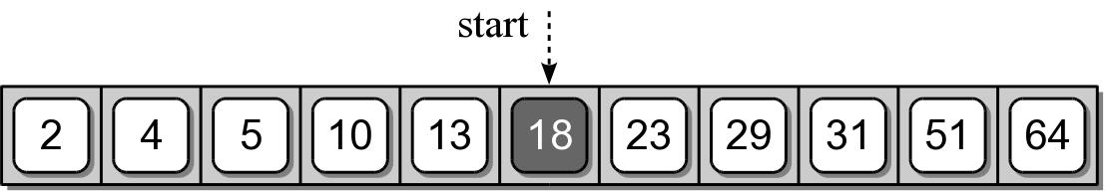
Binary Search Algorithm
Examine the middle item (searching for 10):
One of three possible conditions:
  target is found in the middle item.
  target is less than the middle item.
  target is greater than the middle item.

Slide 10
Binary Search Algorithm
Since the sequence is sorted, we can eliminate half the values from further consideration.

Slide 11
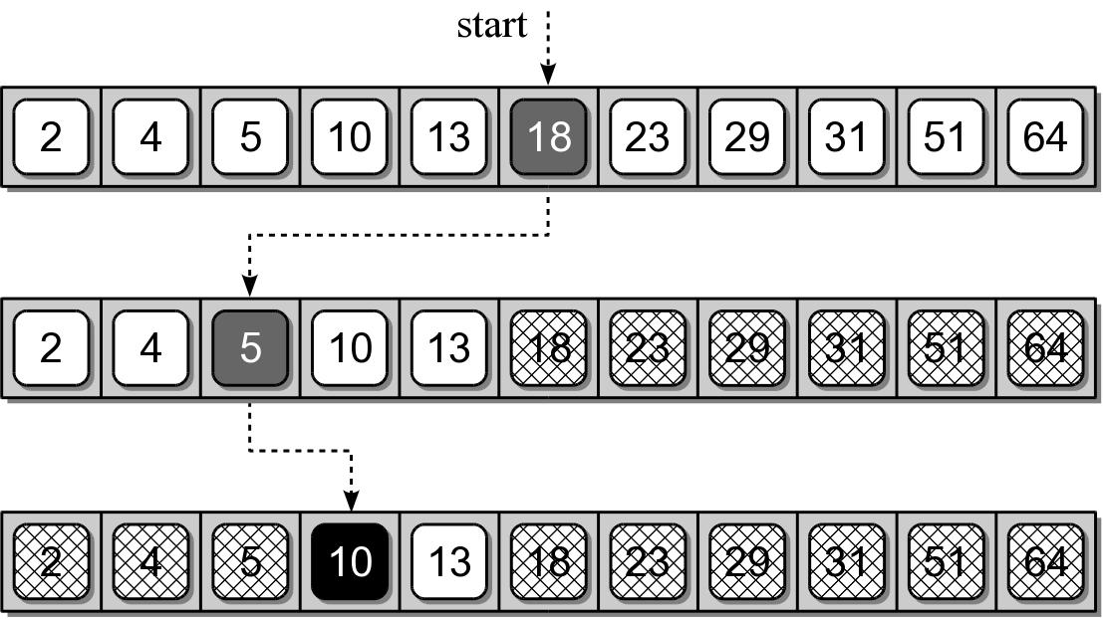
Binary Search Algorithm
Repeat the process until either the target is found or all items have been eliminated.

Slide 12
Binary Search Implementation
def binarySearch( theValues, target ) :
low = 0
high = len(theValues) - 1
while low <= high :
mid = (high + low) // 2
if theValues[mid] == target :
return True
elif target < theValues[mid] :
high = mid - 1
else :
low = mid + 1
return False n = len( theValues )

Slide 13
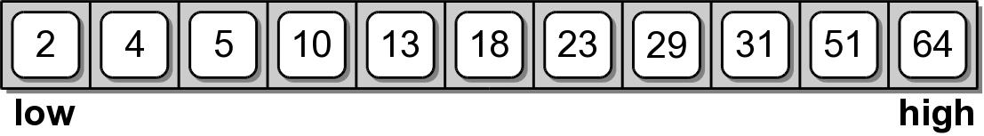
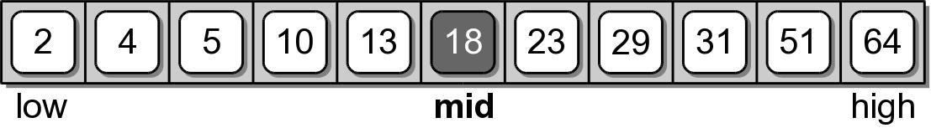
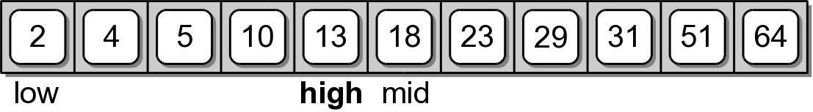
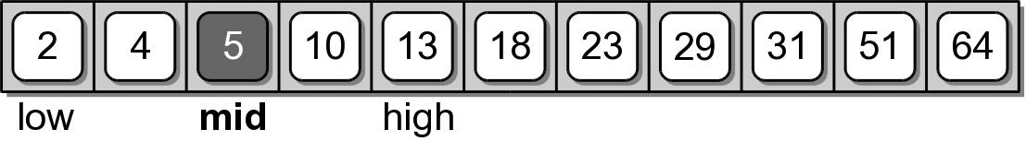
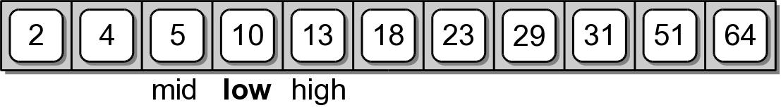
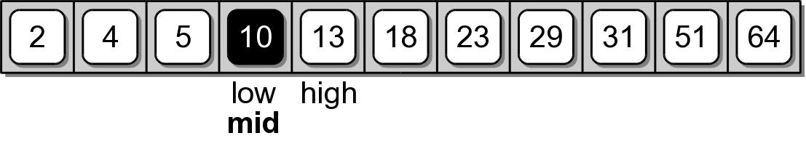
Binary Search Implementation

Slide 14
N.B. BinarySearch is natuurlijk een recursief algoritme
O(log(n))

Slide 15
Sorting
The process of arranging a collection of items such that each item and its successor satisfy a prescribed relationship.
  sequence sort – sorting within a sequence.
  sort key – values on which items are ordered.
  items arranged in ascending or descending order.
  sorted in place – within the same structure.

Slide 16
Bubble Sort
A simple solution to the sorting problem.
Arranges the items by
  iterating over the sequence multiple times.
  larger values bubble to the top (or end).

Slide 17
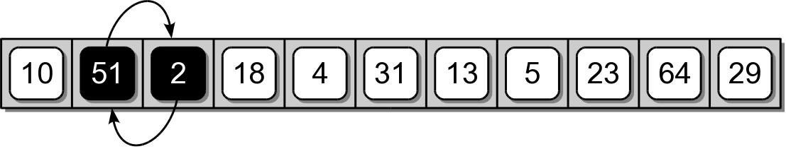
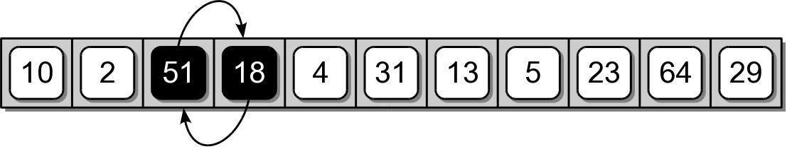
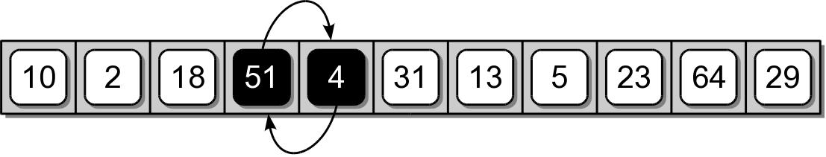
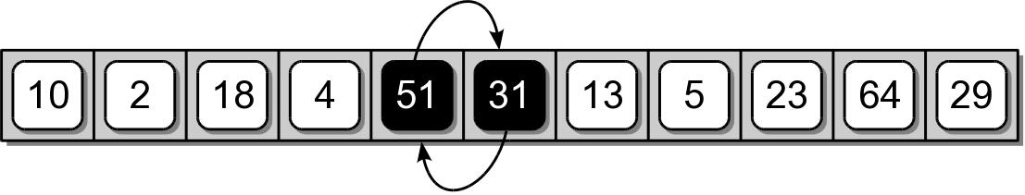
Bubble Sort Example
First complete iteration of the inner loop.

Slide 18
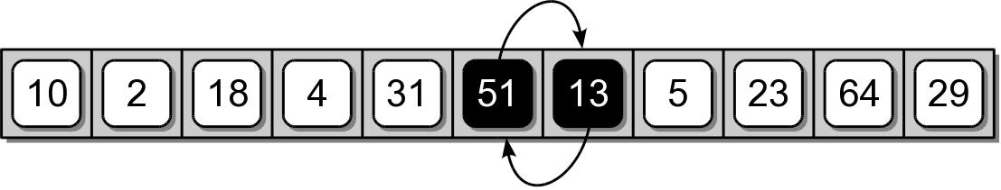
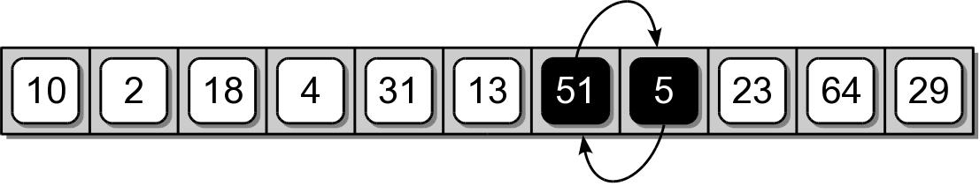
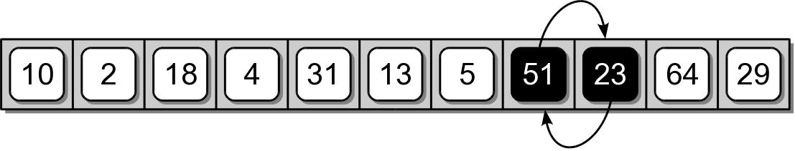
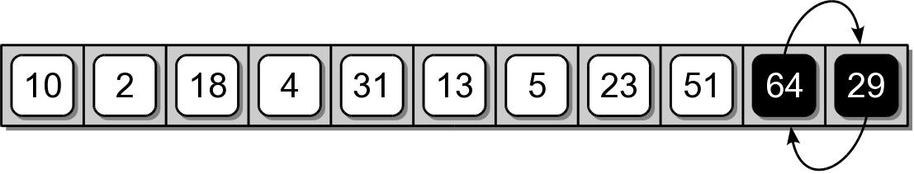
Bubble Sort Example

Slide 19
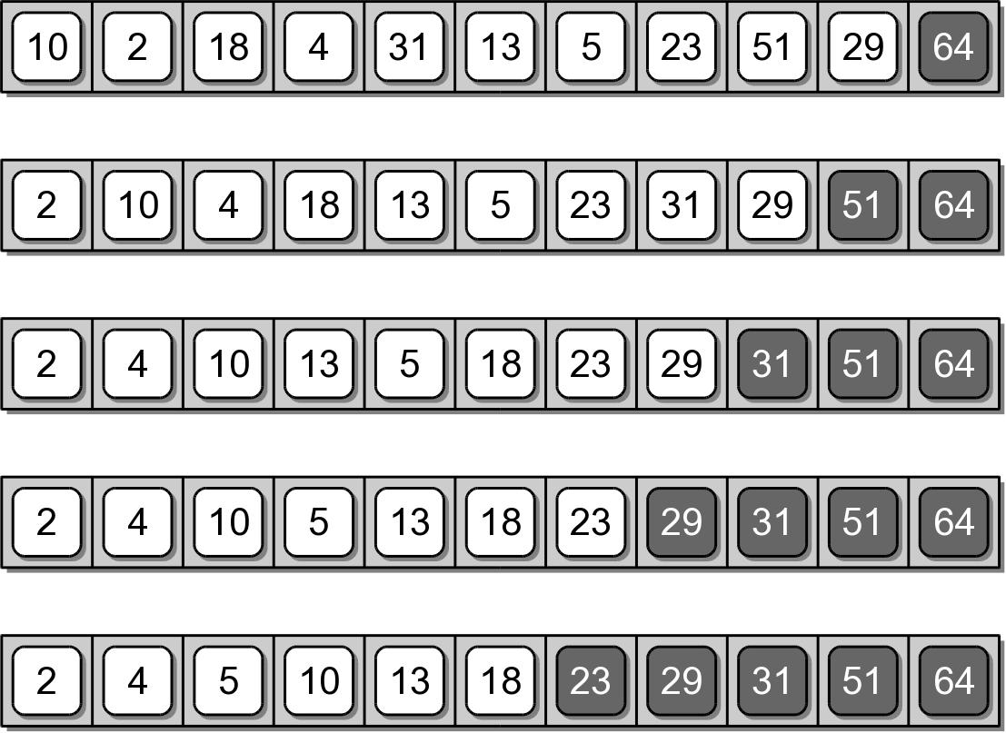
Bubble Sort Example
Results after each iteration of the outer loop.

Slide 20
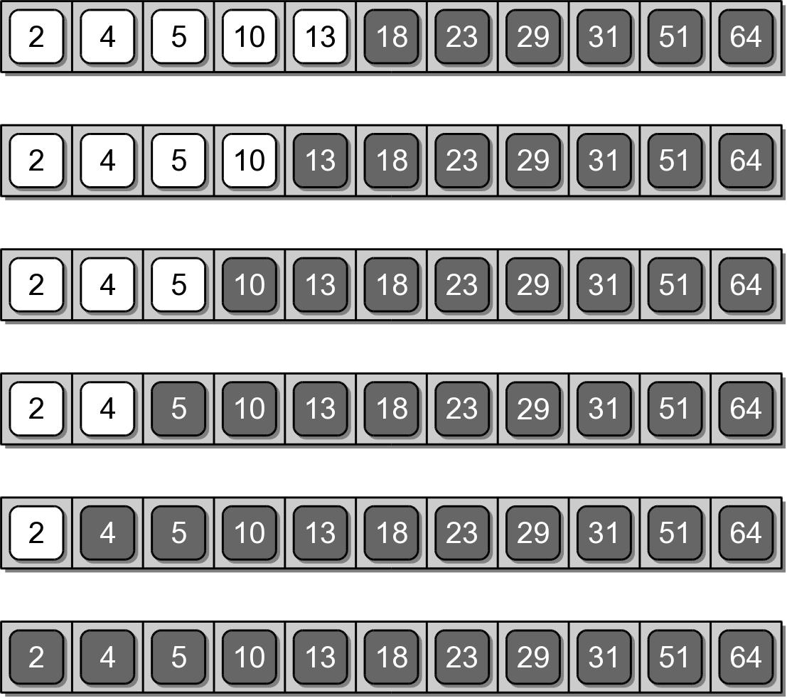
Bubble Sort Example

Slide 21
Bubble Sort Code
def bubbleSort( theSeq ):
n = len( theSeq )
for i in range( n - 1 ) :
for j in range( i + n - 1 ) :
if theSeq[j] > theSeq[j + 1] :
tmp = theSeq[j]
theSeq[j] = theSeq[j + 1]
theSeq[j + 1] = tmp

Slide 22
Selection Sort
Improves on the bubble sort.
Works in a fashion similar to what a human may use to sort a sequence.
Instead of swapping many items,
  repeatedly selects the next largest item from among the unsorted items.
  requires a search to select the smallest item.

Slide 23
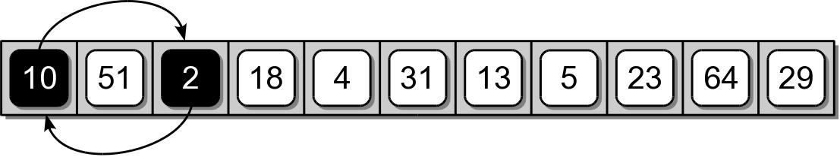
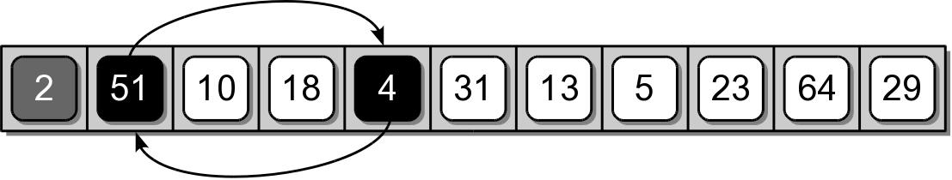
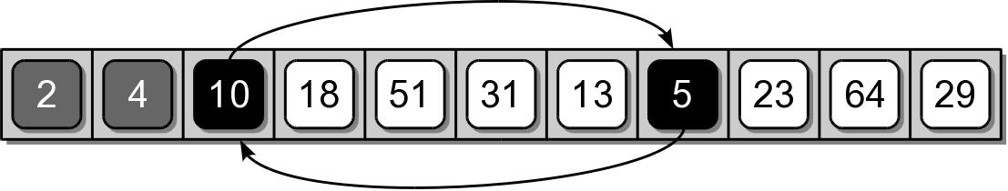
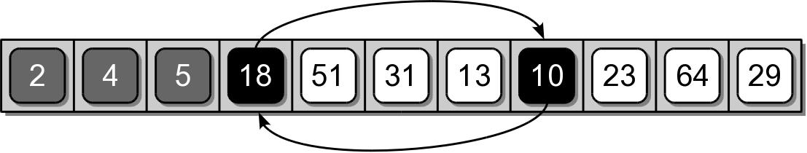
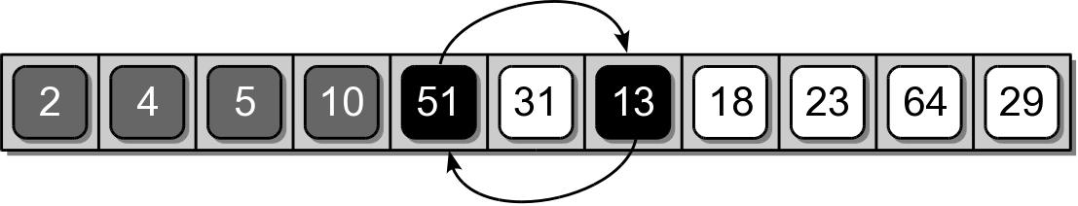
Selection Sort Example

Slide 24
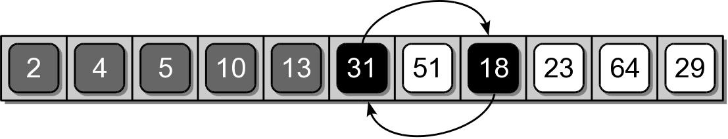
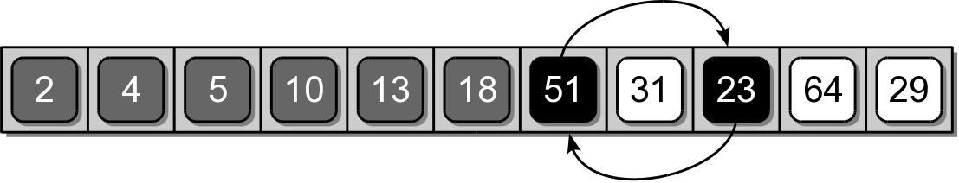
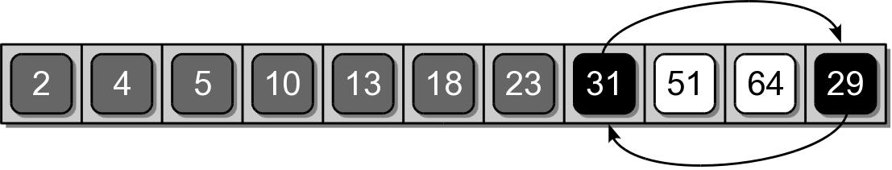
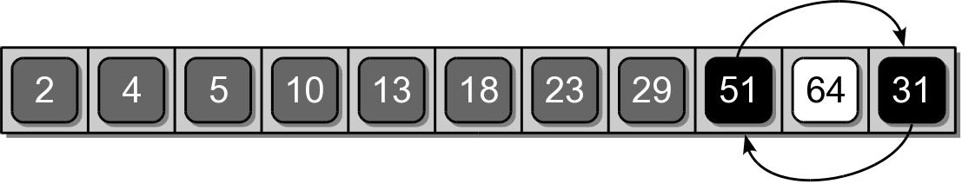
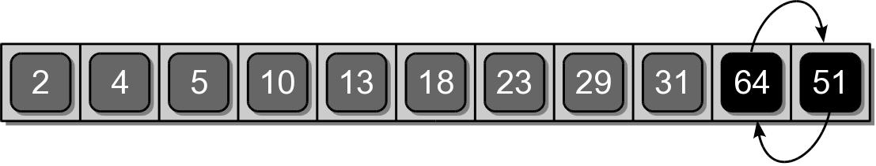
Selection Sort Example

Slide 25
Selection Sort Code
def selectionSort( theSeq ):
n = len( theSeq )
for i in range( n - 1 ):
smallNdx = i
for j in range( i + 1, n ):
if theSeq[j] < theSeq[smallNdx] :
smallNdx = j
if smallNdx != i :
tmp = theSeq[i]
theSeq[i] = theSeq[smallNdx]
theSeq[smallNdx] = tmp

Slide 26
Insertion Sort
Another commonly studied algorithm.
Arranges the items by
  iterating over the sequence one complete time.
  inserts each unsorted item into its proper place.

Slide 27
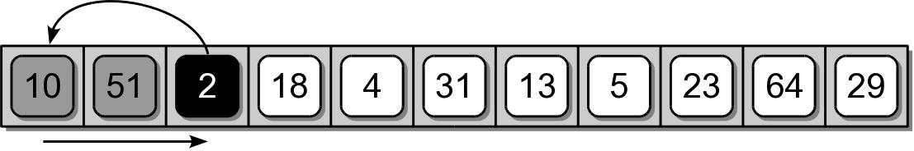
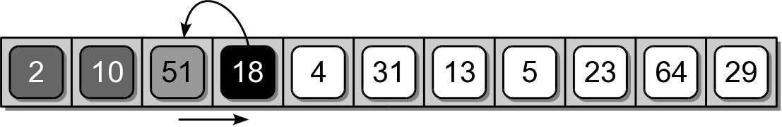
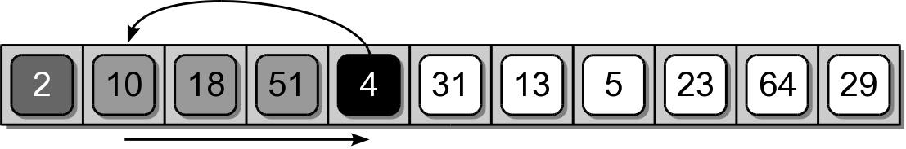
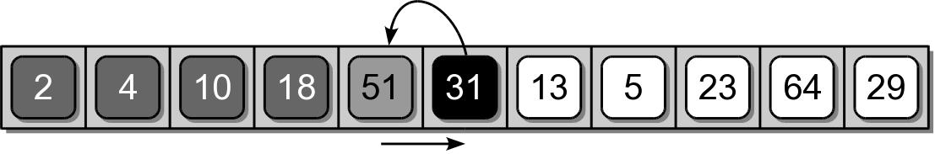
Insertion Sort Example

Slide 28
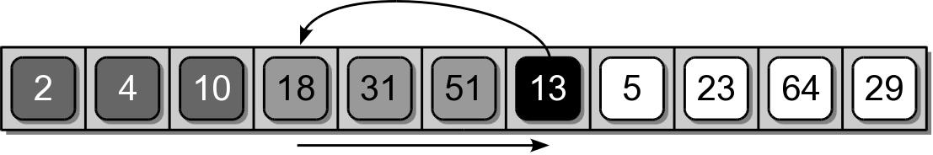
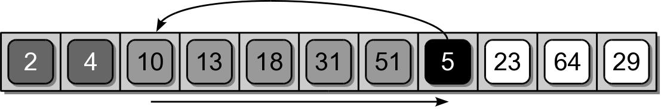
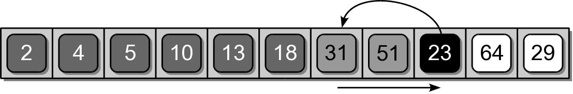
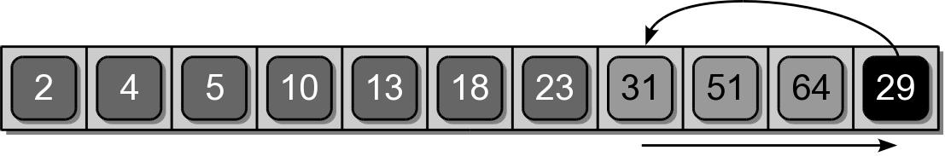
Insertion Sort Example

Slide 29
Insertion Sort Code
def insertionSort( theSeq ):
n = len( theSeq )
for i in range( 1, n ) :
value = theSeq[i]
pos = i
while pos > 0 and value < theSeq[pos - 1] :
theSeq[pos] = theSeq[pos - 1]
pos -= 1
theSeq[pos] = value

Slide 30
Working With Sorted Lists
The efficiency of some algorithms can be improved when working with sorted sequences.
  For non-static collections, it would be inefficient to re-sort a sequence for each add/remove.
  Better to maintain a sorted sequence.

